Slide 1
RGV Ecoregion Analysis
Bridgett Collis

Slide 2
Analyzing Land Use in the RGV and Fort Brown Resaca Watershed using TPWD Ecoregions
Texas Parks and Wildlife Ecological Systems Classification and Mapping Project
The Western Gulf Coastal Plain and The Southern Texas Plains ecoregions shapefiles
Texas County Boundaries Detailed shapefile from GIS-TxDot
The ecoregion shapefile was clipped using the clip feature to the following shapes:
Cameron county
Hidalgo county
Willacy county
Starr county
RGV
Fort Brown resaca watershed.

Slide 3
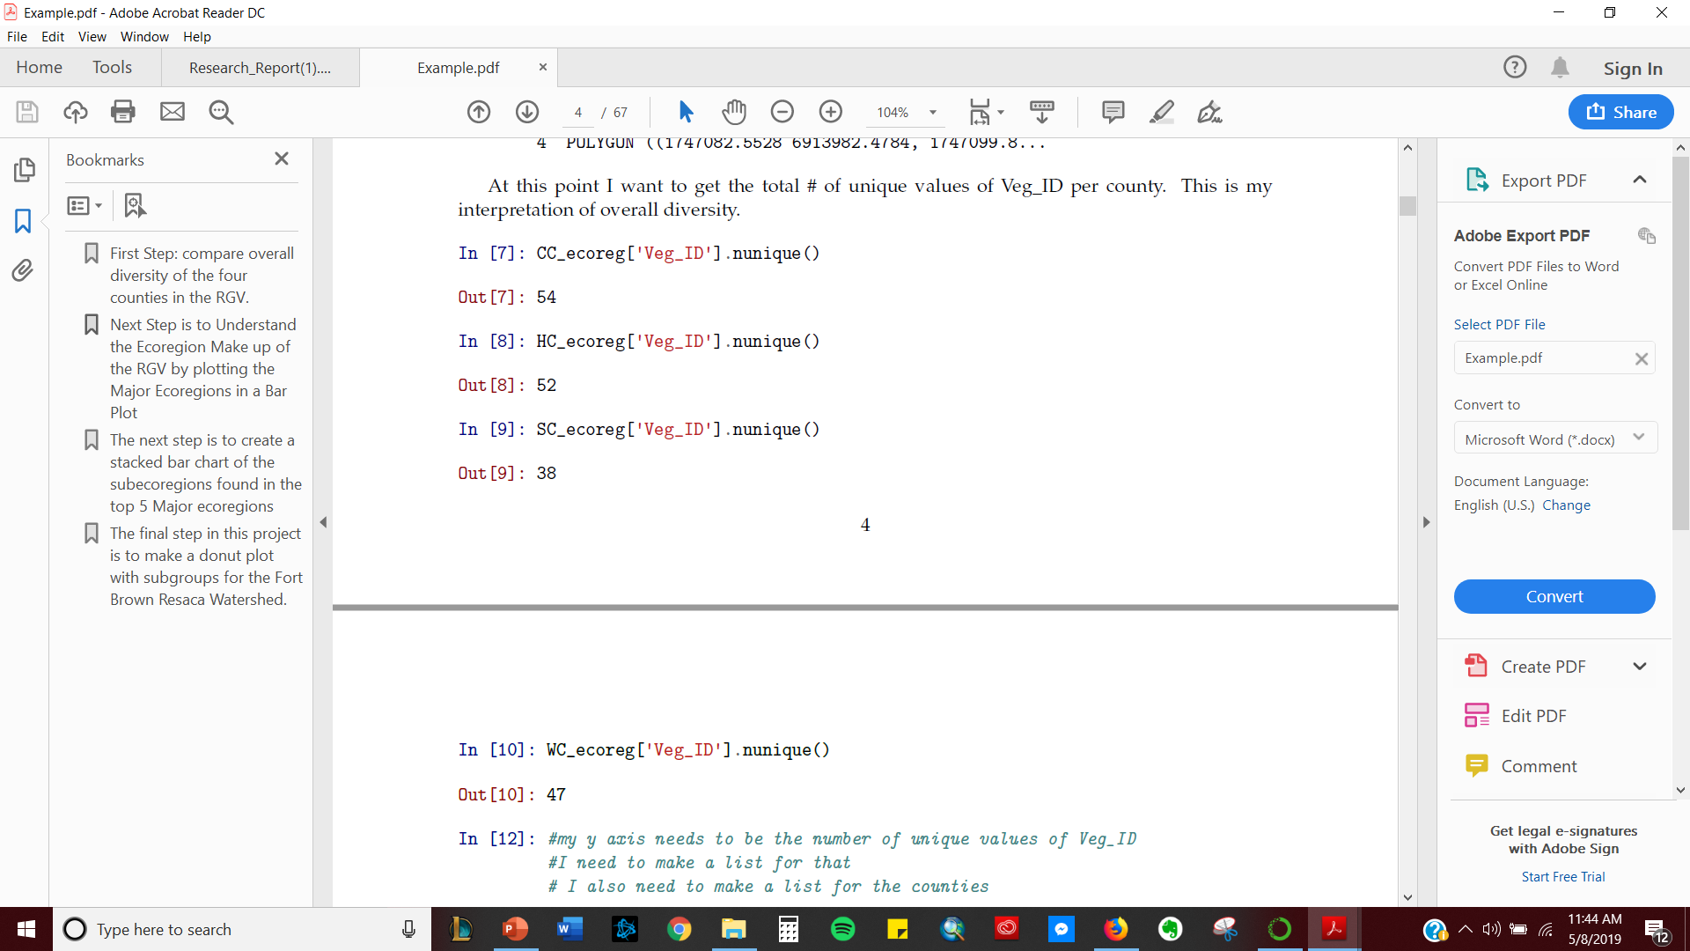
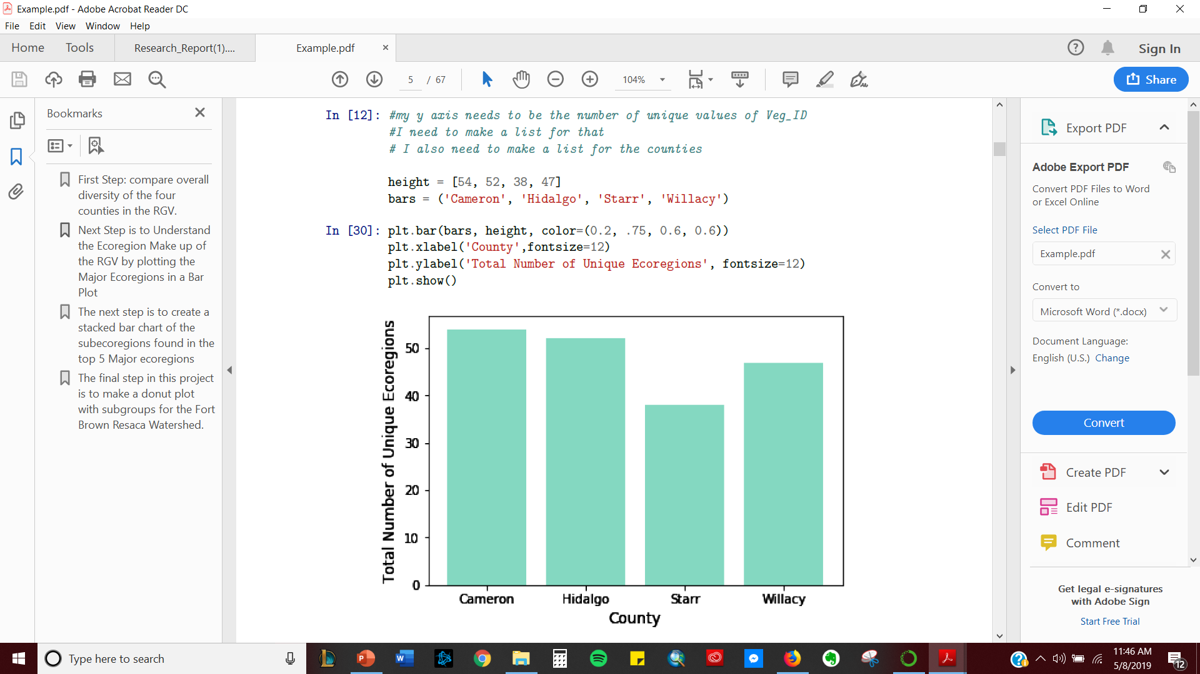
Comparison of Biodiversity in RGV Counties
1. Load_shapefile_function using geopandas
2.
3.

Slide 4
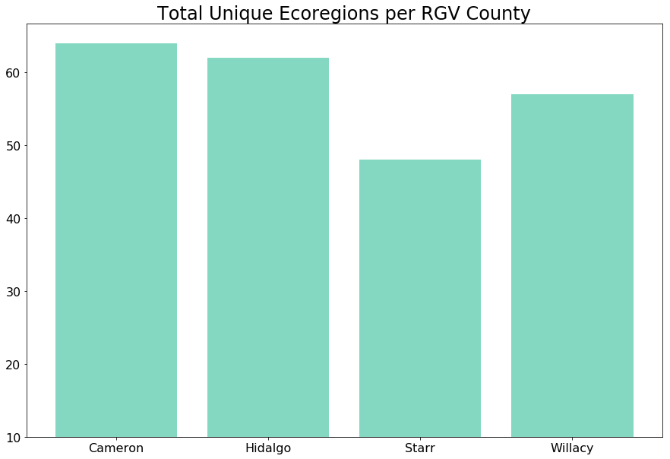
Total Number of Unique Ecoregions
County

Slide 5
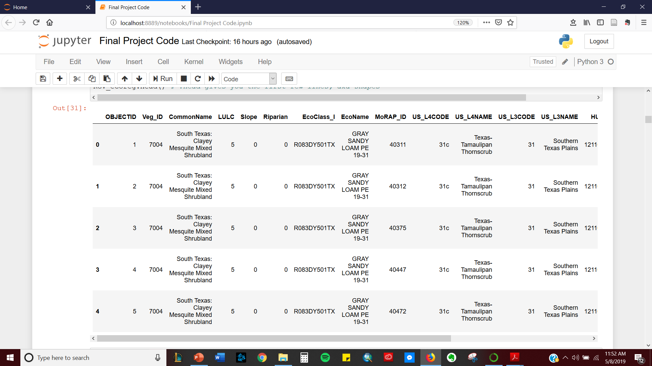

Comparison of Biodiversity in RGV Counties
1. Load RGV shapefile

Slide 6
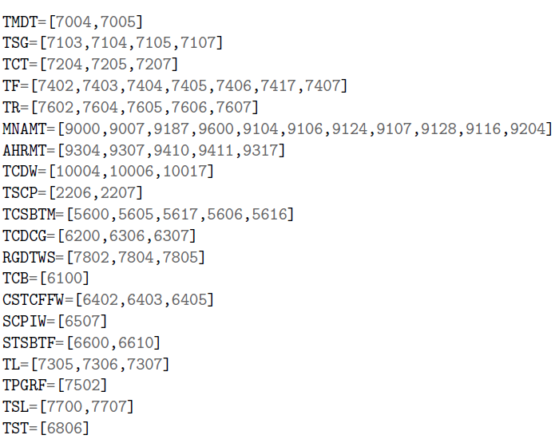
For Loops
Assign Veg_ID unique values to Major Ecoregion Variables
Create an empty list
Loop through Veg_ID Column
Append list based on the variable that the Veg_ID corresponds to

Slide 7
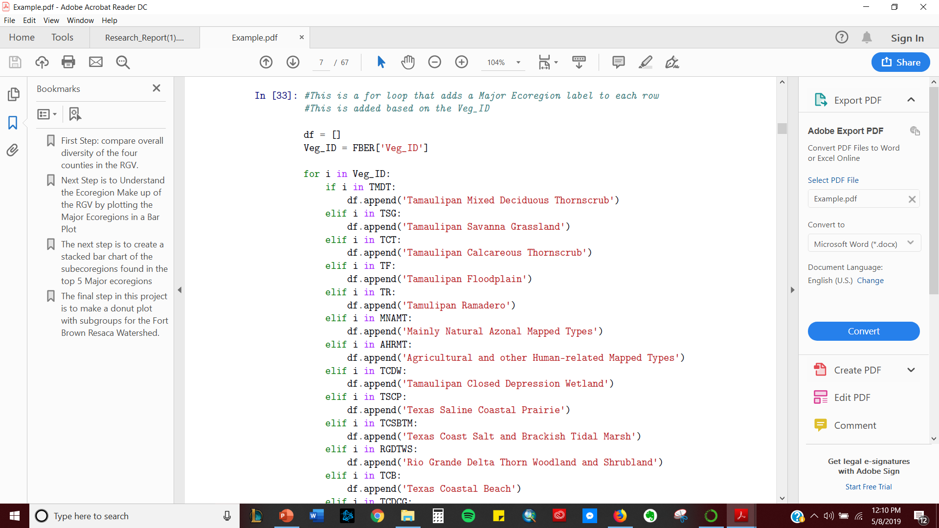
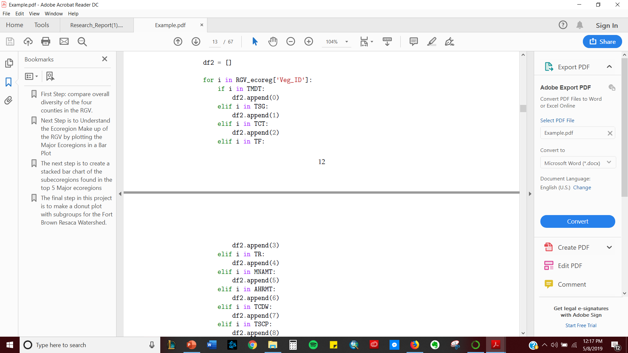
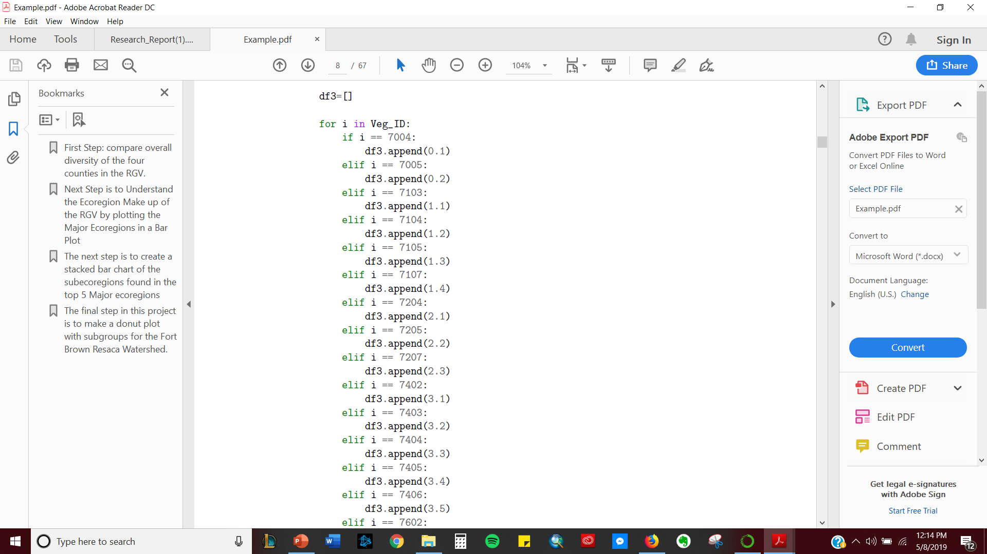
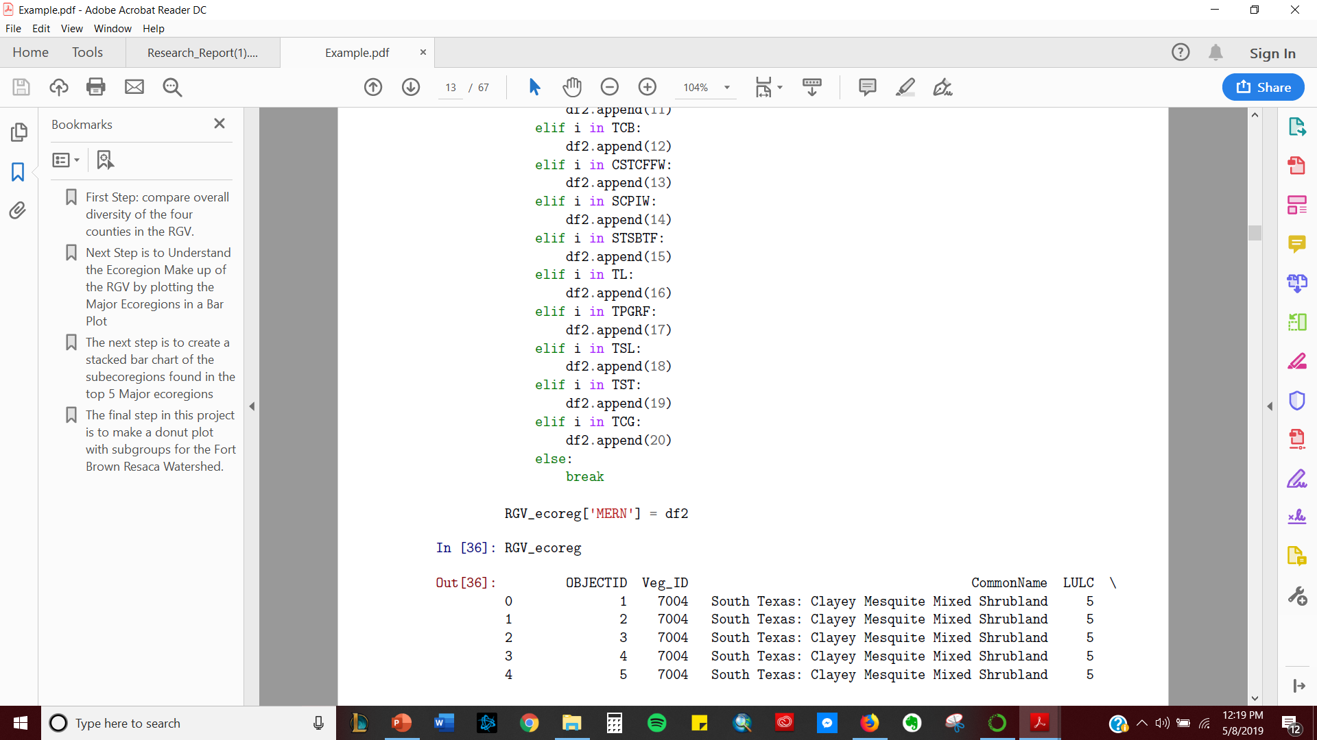
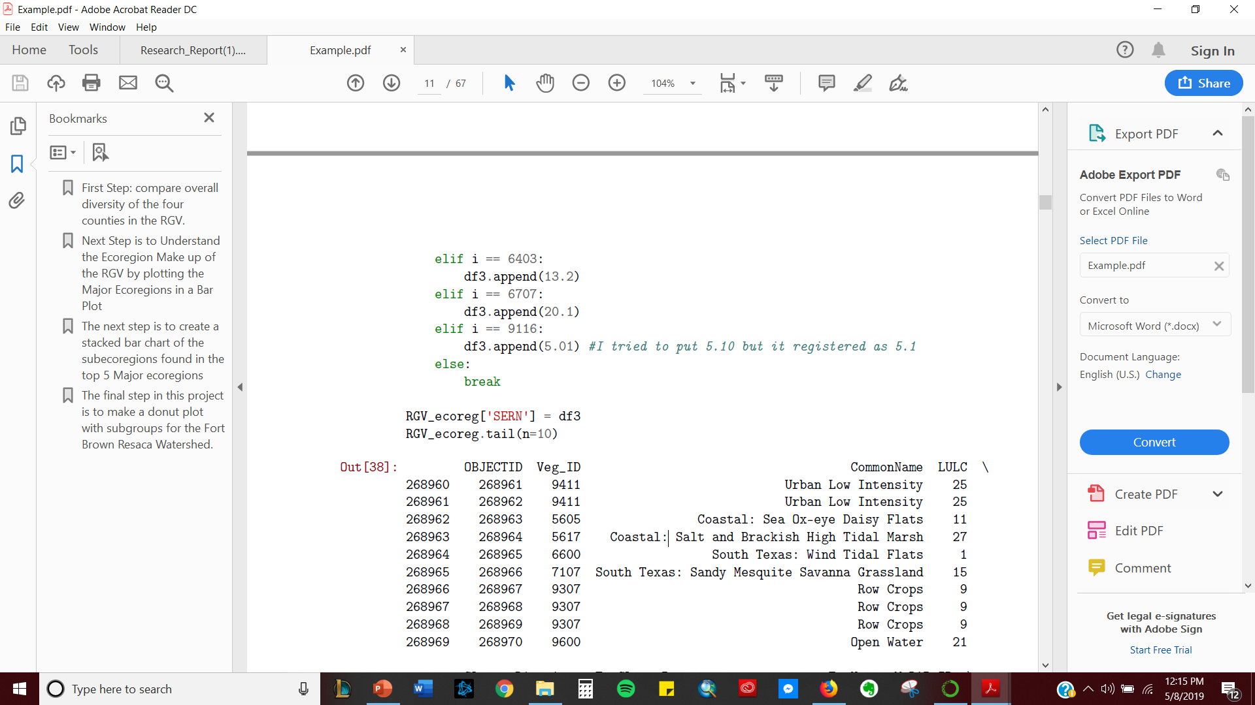
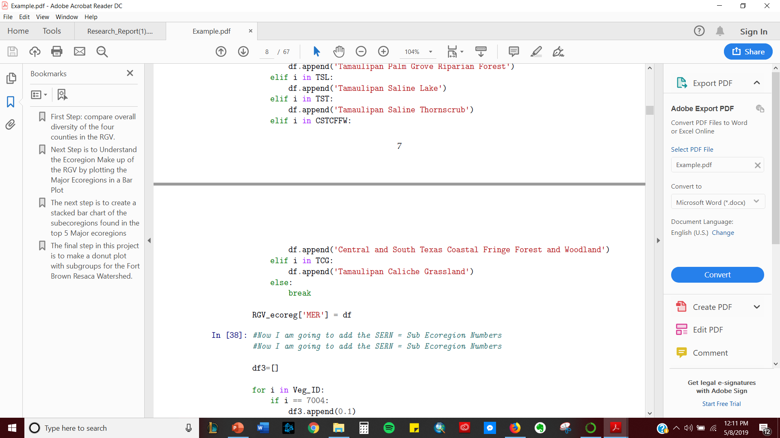
…
…
…

Slide 8
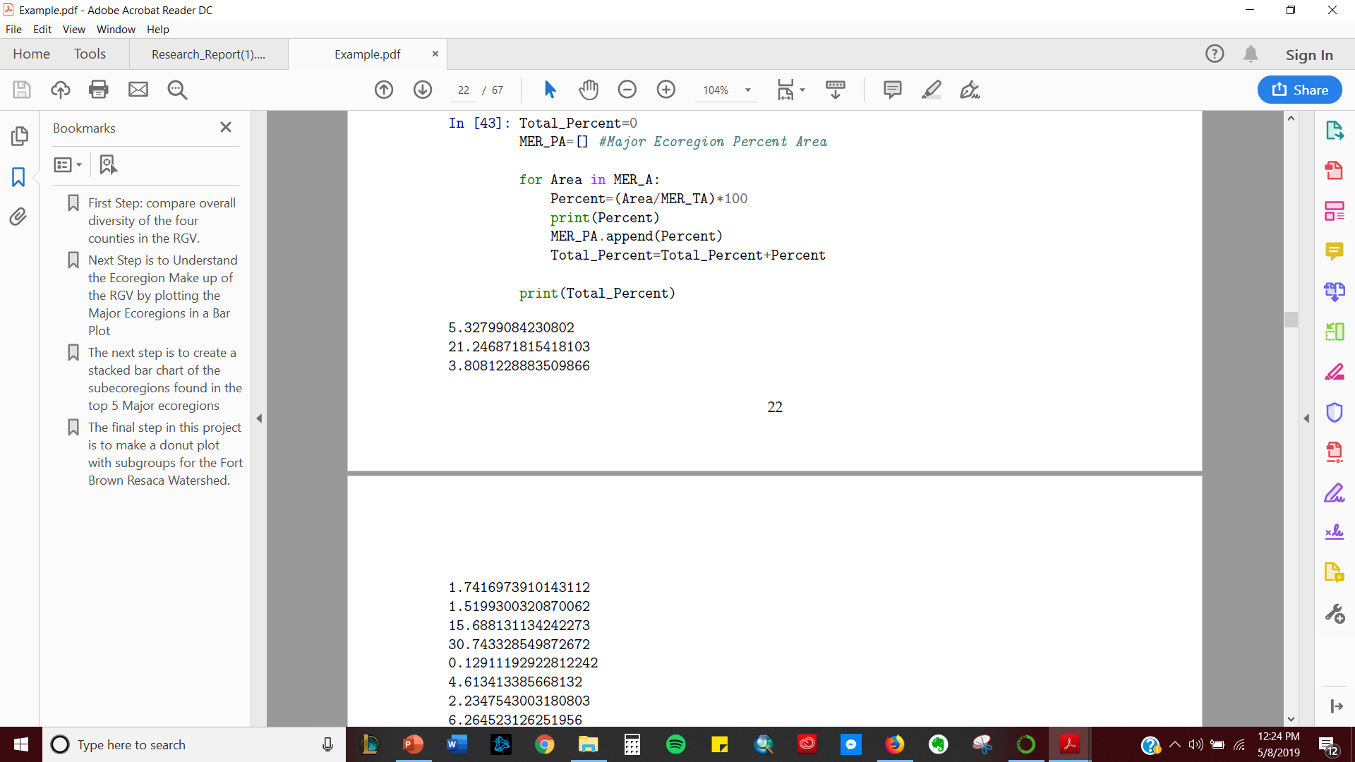
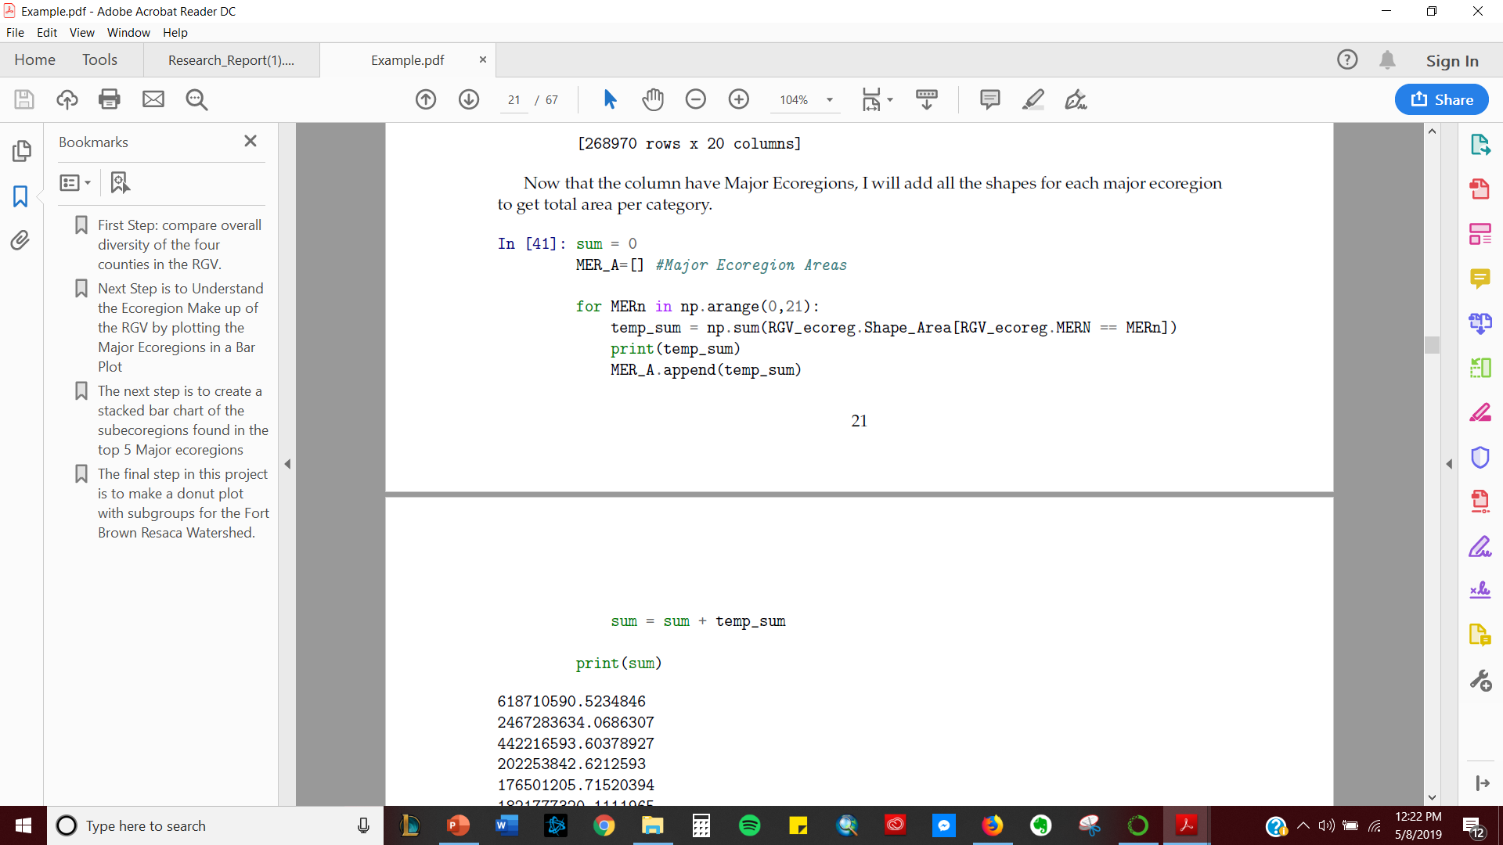
Total Area per Major Ecoregion

Slide 9
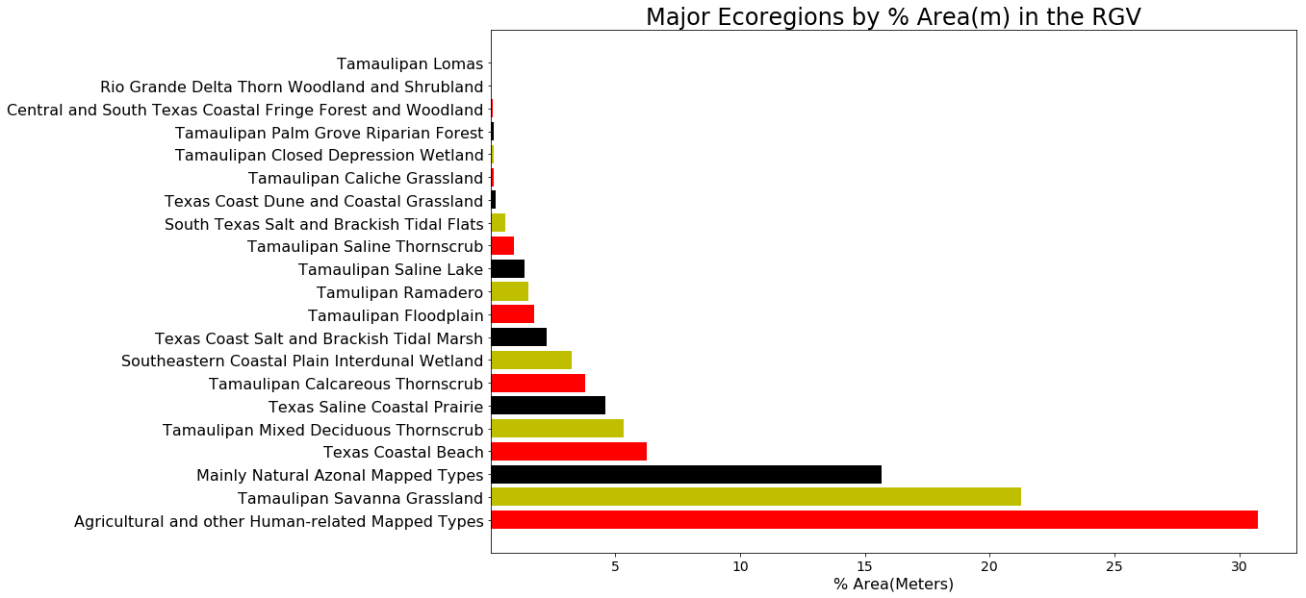
5.3%
15.7%
6.3%
21.2%
30.7%

Slide 10
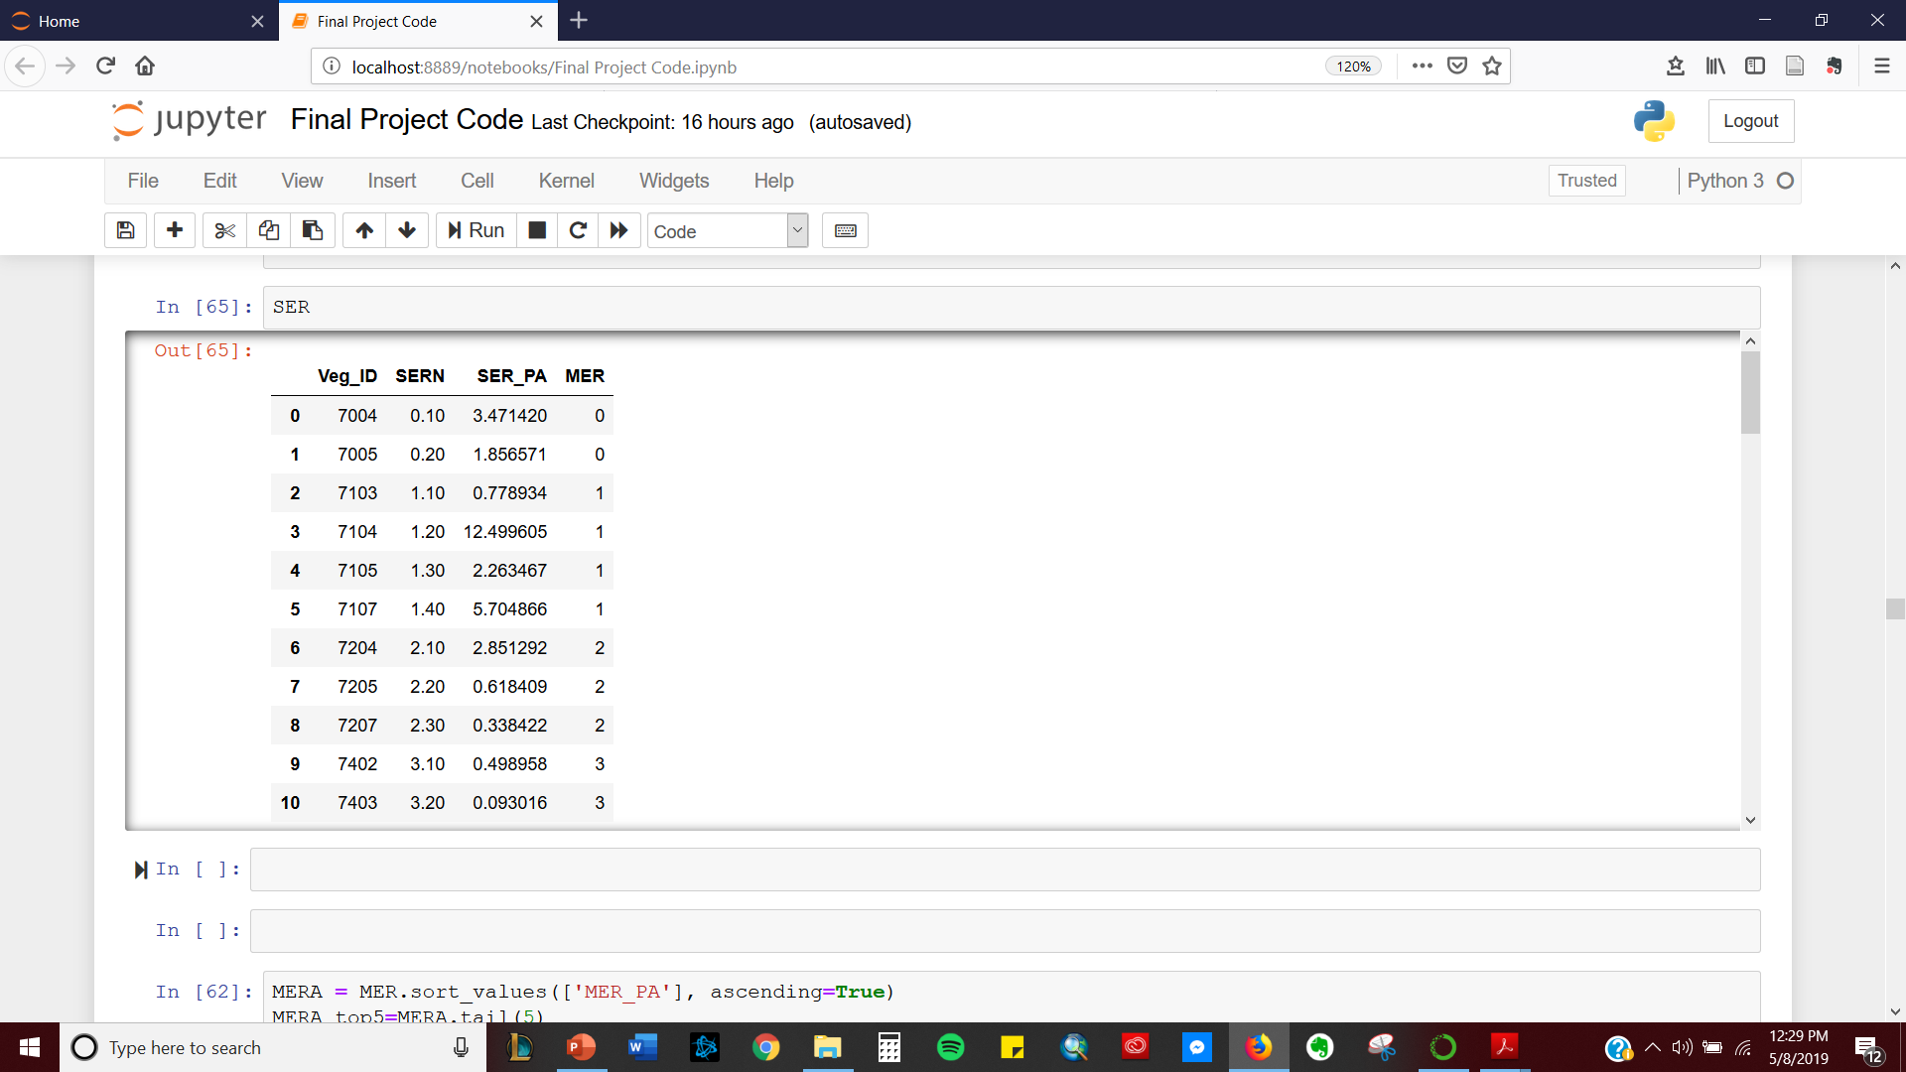
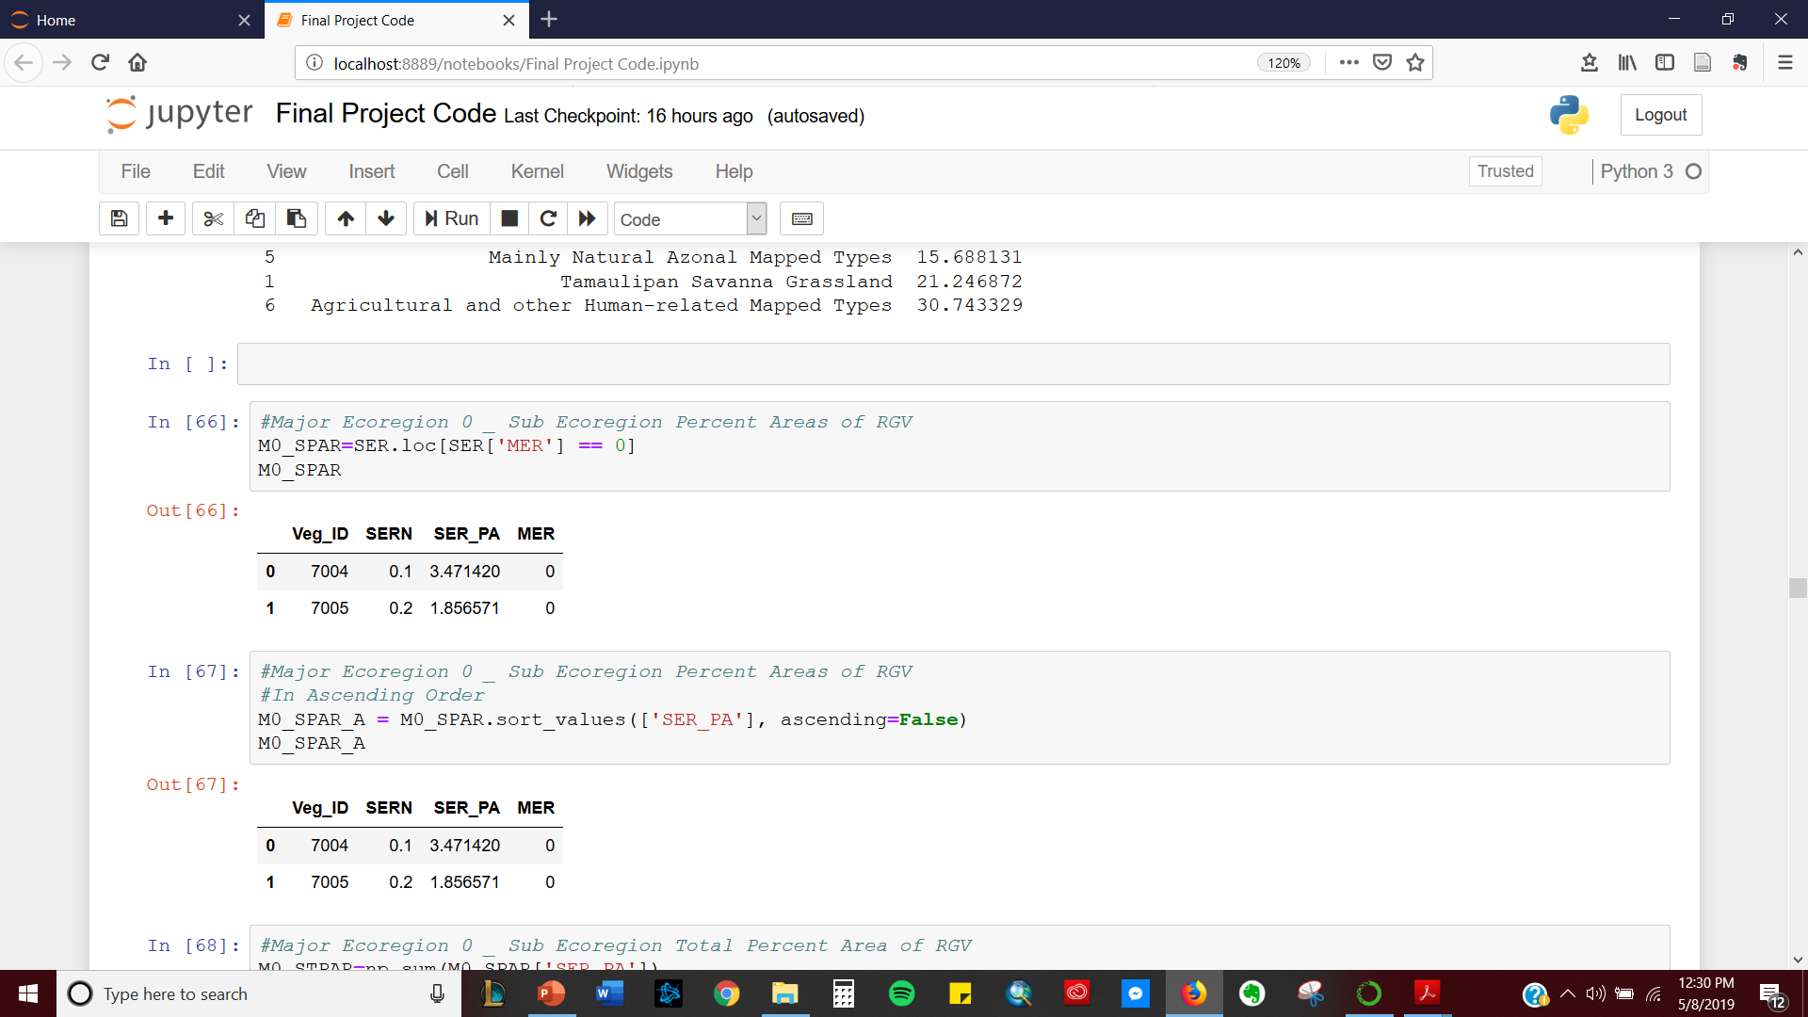
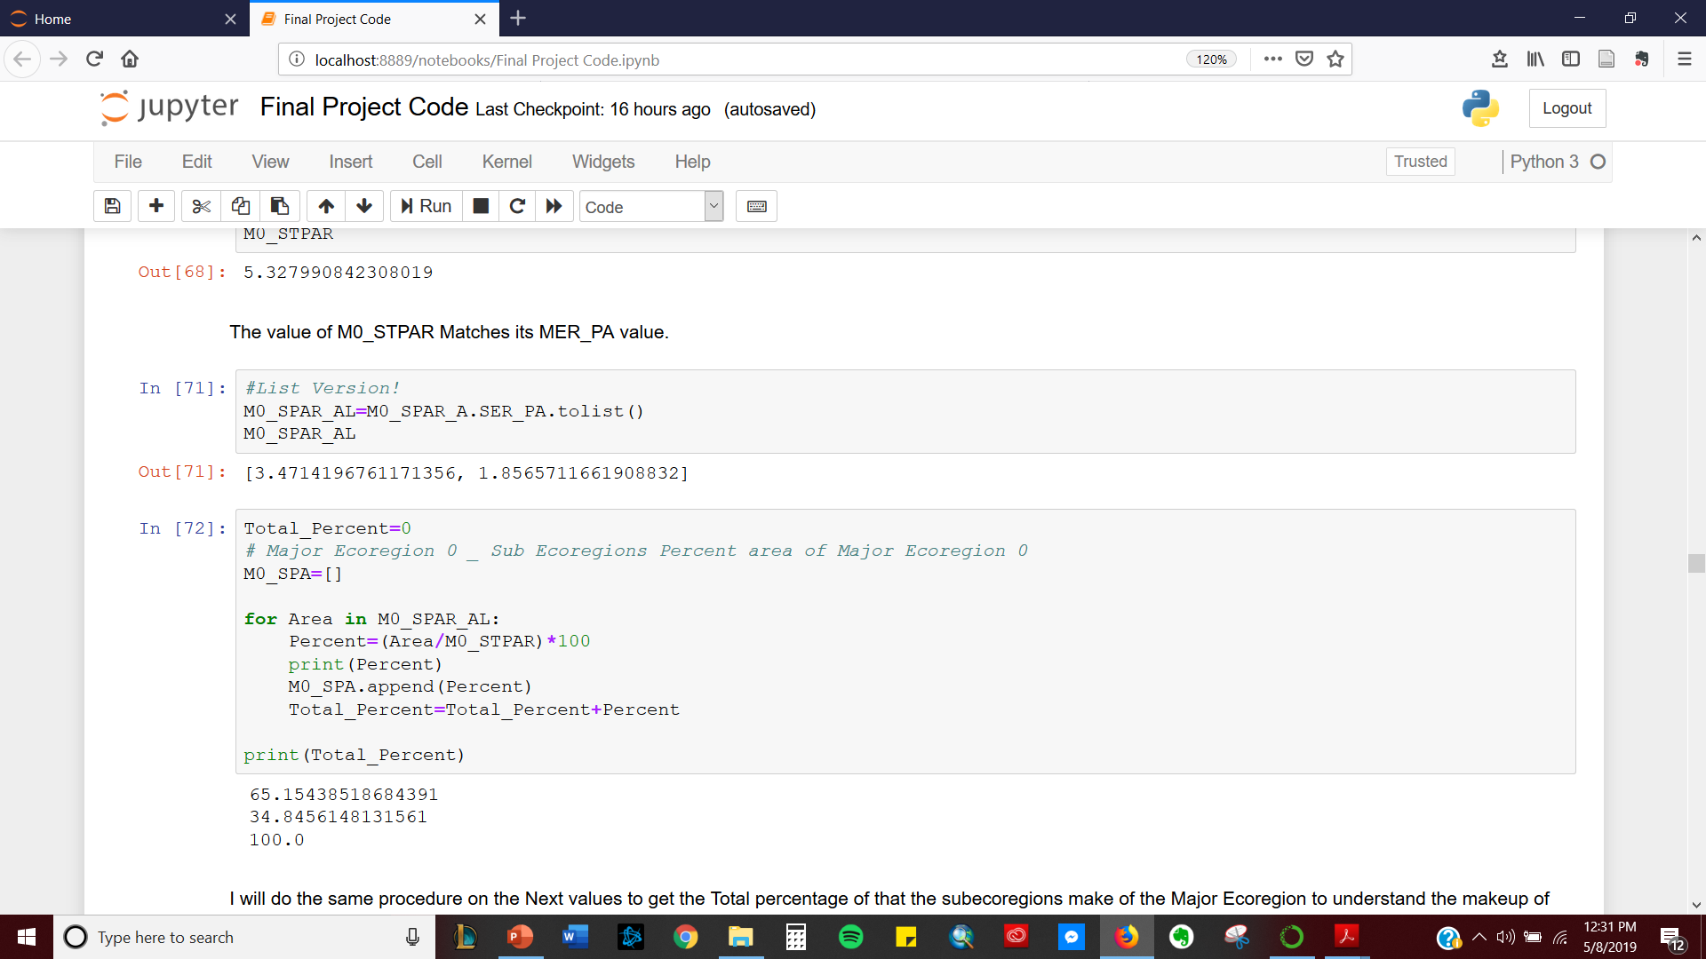
Stacked Bar Plot of Subecoregions of Top 5 Major Ecoregions of the RGV

Slide 11
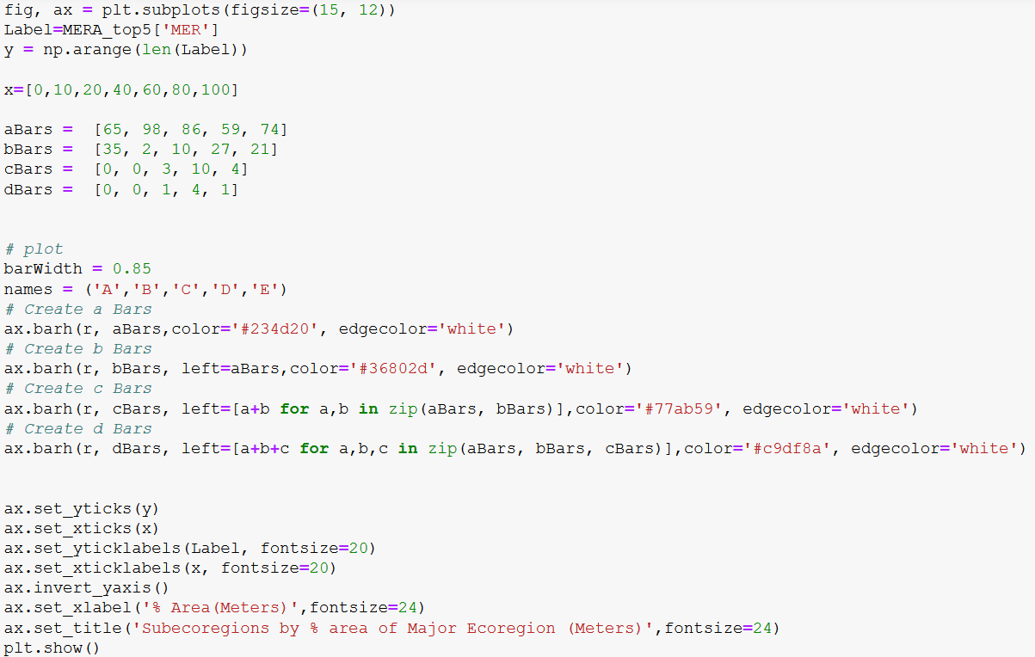

Slide 12
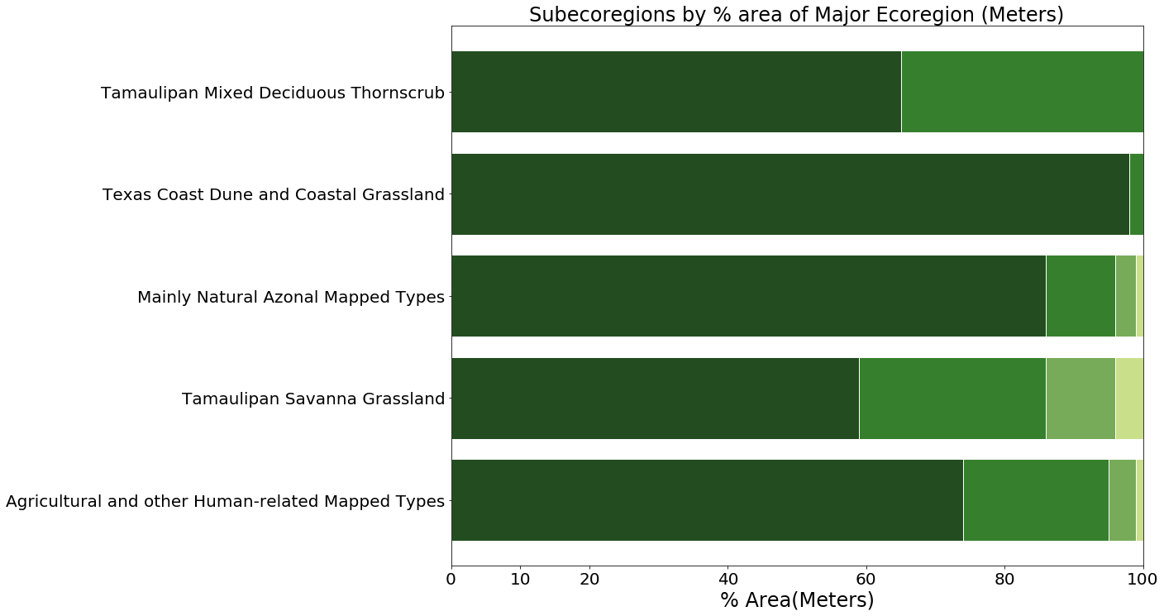
RGV
35% : Clayey Blackbrush Mixed Shrubland
65% : Clayey Mesquite Mixed Shrubland
98% : Coastal and Sandsheet: Dune and Coastal Grassland
86% : South Texas: Disturbance Grassland
59% : South Texas: Sandy Mesquite Woodland and Shrubland
27% : Sandy Mesquite Savanna Grassland
74% : Row Crops
21% : Urban Low Intensity

Slide 13
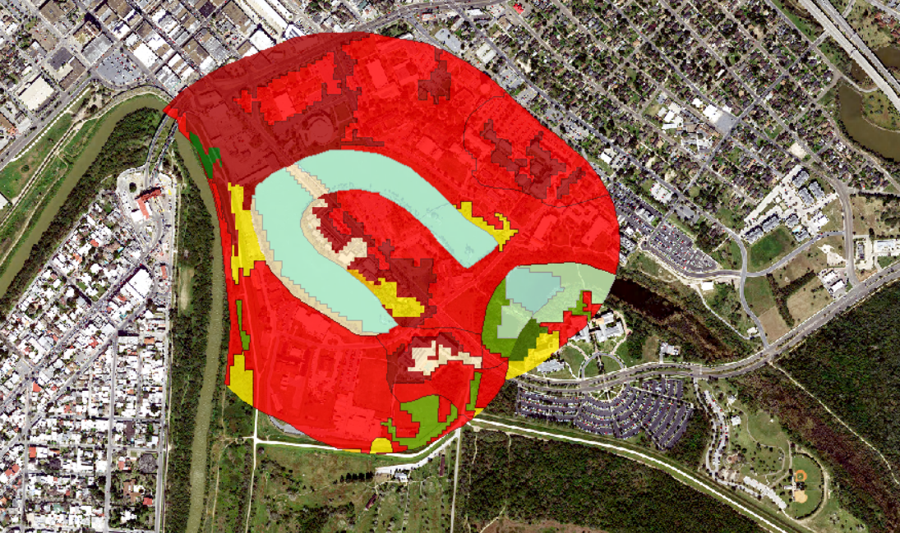
Fort Brown Resaca Watershed Ecoregions

Slide 14
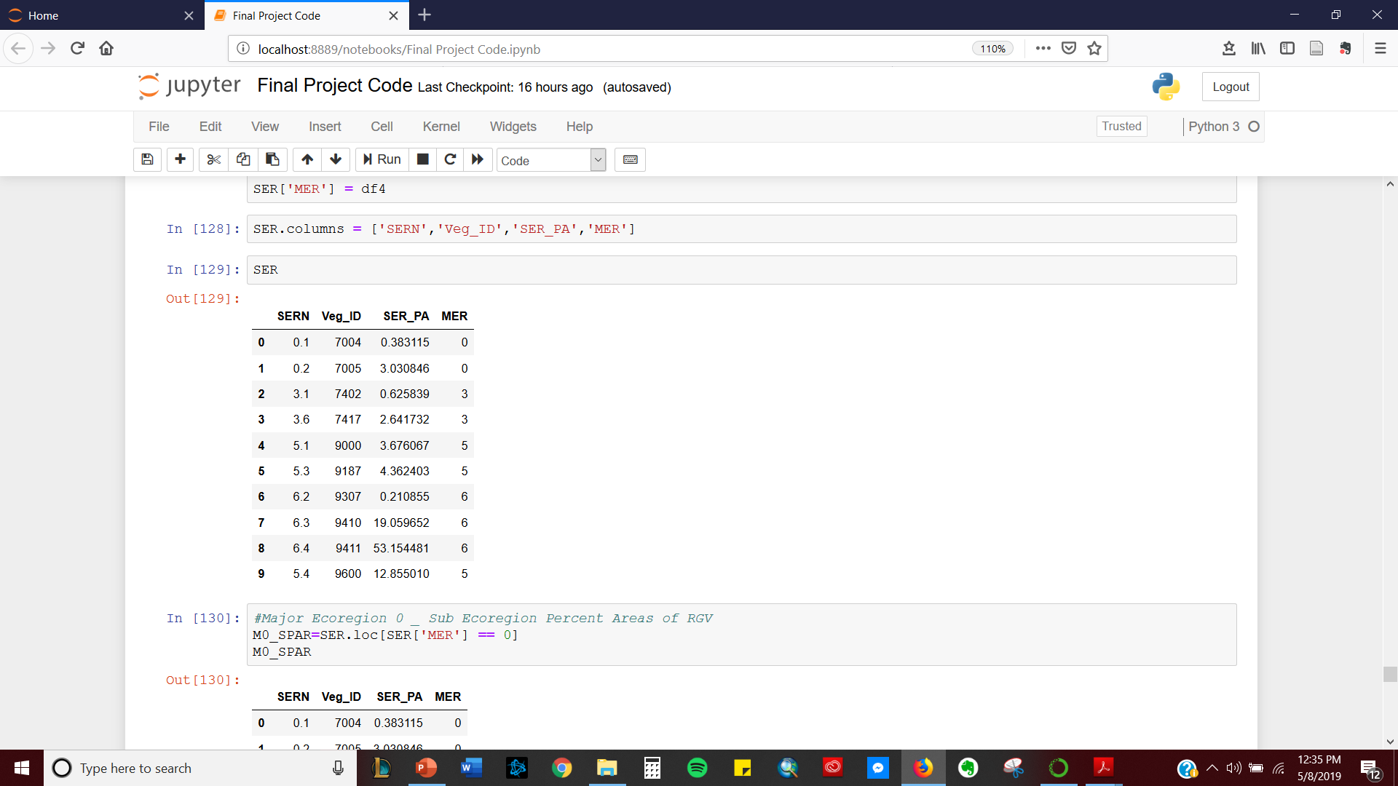
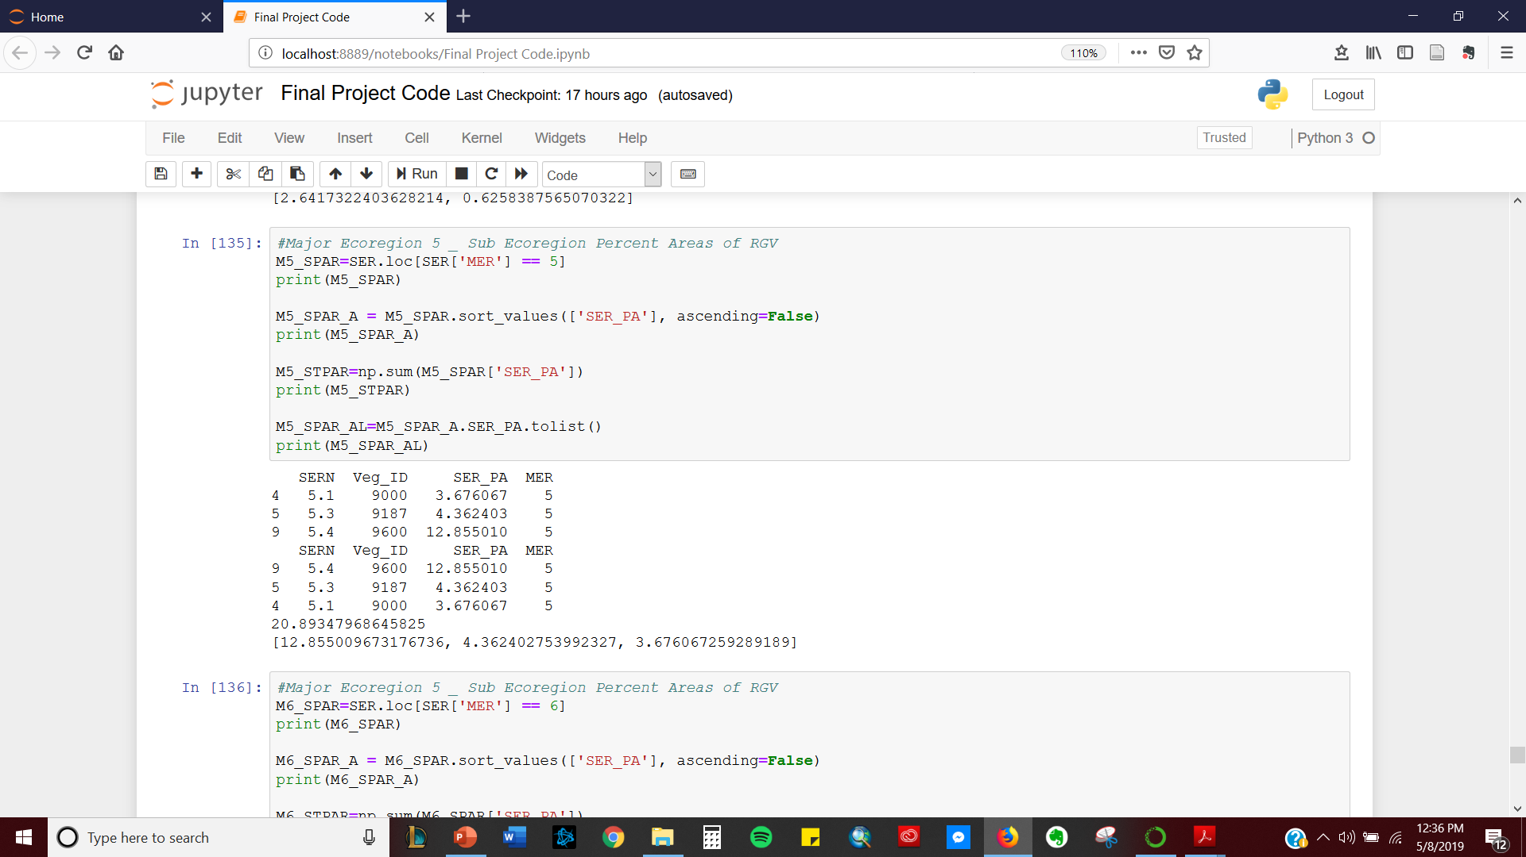
Donut Plot of Fort Brown Resaca Watershed Ecoregions

Slide 15
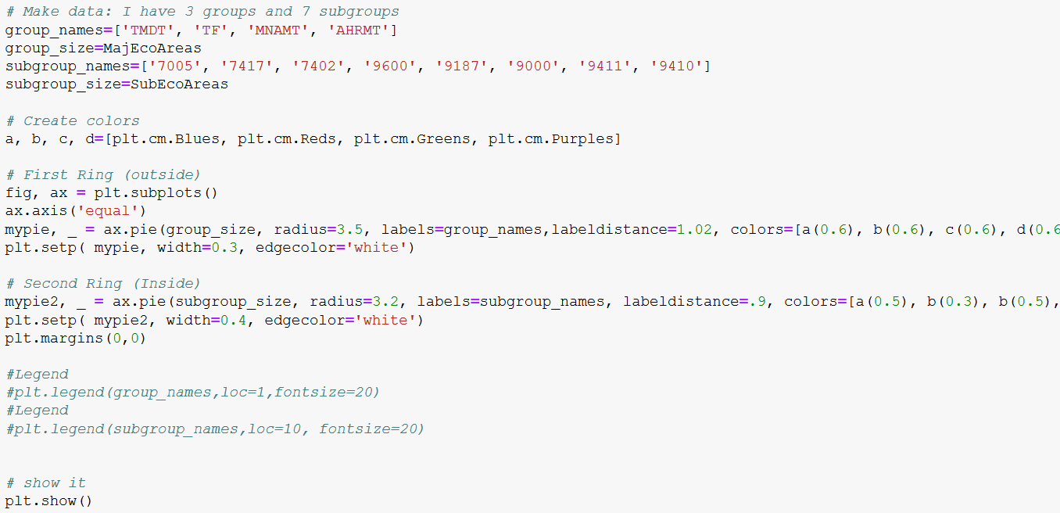

Slide 16
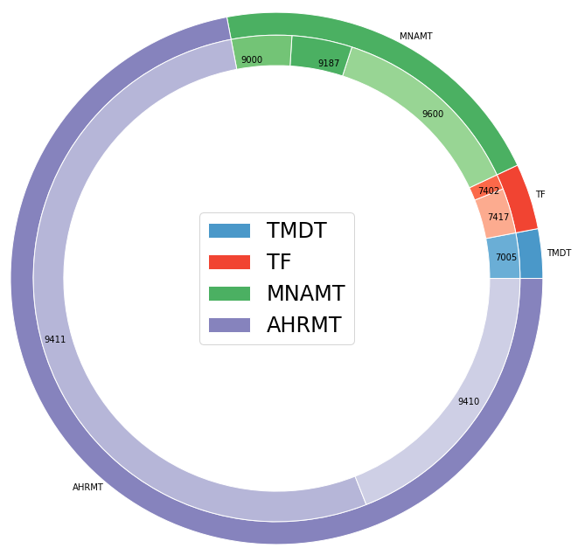
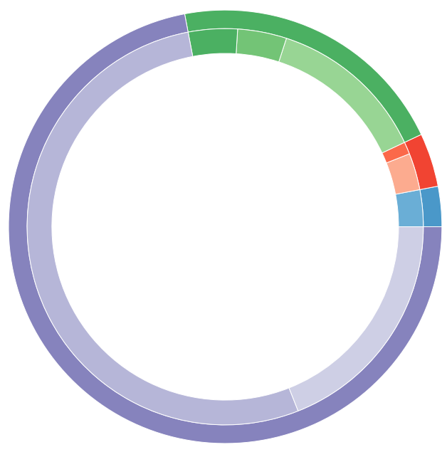
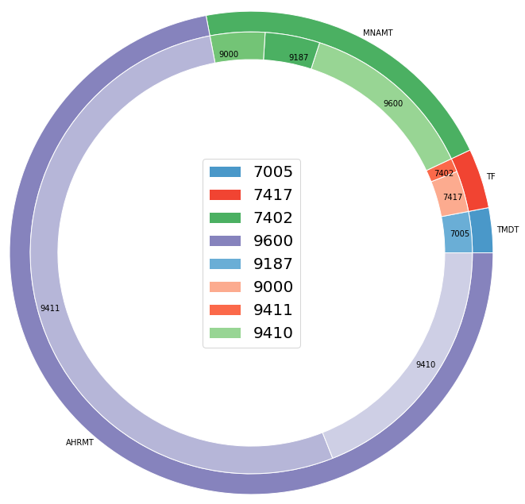
Fort Brown Resaca Watershed Ecoregions (% Area in Meters)
: 3 % Tamaulipan Mixed Deciduous Thornscrub
MNAMT
: 3 % Clayey Blackbrush Mixed Shrubland
: 4 % Tamaulipan Floodplain
: 3 % Floodplain Herbaceous Wetland
TF
: 1 % Floodplain Evergreen Forest and Woodland
AHRMT
TMDT
: 21 % Mainly Natural Azonal Mapped Types
: 13 % Open Water
: 4 % Disturbance Grassland
: 4 % Barren
: 72 % Agricultural/ Human-related Mapped Types
: 53 % Urban Low Intensity
: 19 % Urban High Intensity

